Slide 1

Exercise: Writing a Data Management Plan
Sarah Jones
Digital Curation Centre, Glasgow
sarah.jones@glasgow.ac.uk
Twitter: @sjDCC
Martin Donnelly
Digital Curation Centre, Edinburgh
martin.donnelly@edinburgh.ac.uk
Twitter: @mkdDCC
Managing Open Science workshop, EURAC, 12 January 2016, Bolzano

Slide 2
Example DMPs
There are 5 example Data Management Plans in your pack:
A syntactically annotated corpus of Appalachian English
A sample DMP for the Wellcome Trust (health sciences)
Assessing and communicating animal disease risks for countryside users
Using NASA remote sensing data to reduce uncertainty of land-use transitions in global carbon-climate models
National Spherical Torus eXperiment Upgrade (a fusion energy experiment at the Princeton Plasma Physics Laboratory)

Slide 3
A syntactically annotated corpus of Appalachian English
Project submitted to the National Endowment for the Humanities (NEH) in the United States
Creating audio recordings of Appalachian speech, a 1,000,000-word corpus and associated text files
Collaborating with the City University of New York’s High Performance Computer Centre to storage, manage and preserve the data
www.neh.gov/divisions/odh/grant-news/data-management-plans-successful-grant-applications-2011-2014-now-available

Slide 4
A sample DMP for the Wellcome Trust
Project creating questionnaire and interview data, clinical measurements and biological samples
Confidentiality issues and data sharing agreements covered
Support provided by London School of Hygiene and Tropical Medicine (LSHTM)
Example plan part of wider guide on writing DMPs
www.lshtm.ac.uk/research/researchdataman/plan/ wellcometrust_dmp.pdf

Slide 5
Assessing and communicating animal disease risks for countryside users
Social science example submitted to the Rural Economy and Land Use (RELU) programme
Involves a lot of reuse of existing data
Conducting interviews, questionnaires and focus groups, as well as creating GIS data
Multi-partner project so data storage and backup covered for each site
http://relu.data-archive.ac.uk/media/25706/exampledmp_fr.pdf

Slide 6
Using NASA remote sensing data
Project from the Department of Geography at the University of Maryland, submitted to the Terrestrial Ecology Program
Will produce data in NetCDF and ASCII format
DMP covers data quality assessment before public release of the data
Detailed information on how data will be shared, based on previous examples of doing this
https://daac.ornl.gov/PI/Data_Management_Plan_Chini_NASA_TE.pdf

Slide 7
National Spherical Torus eXperiment
The NSTX is an innovative magnetic fusion device to explore the potential of fusion energy as a safe, affordable and environmentally sound means of generating electricity.
The DMP covers the different types of data (raw, reduced & analysed) and how these will be stored and archived
Public access to data underlying publications and collaboration agreements for usage of further data are outlined
DMP links out to other documents and resources
http://nstx-u.pppl.gov/data-management-plan

Slide 8
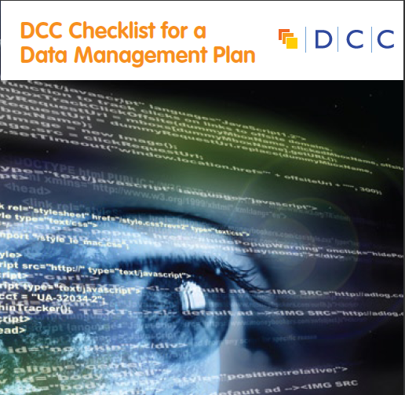
DMP exercise
Read through one or two example DMPs to get a sense of what to write.
Discuss with your partner or in small groups what you like about the plan(s) and would replicate.
Pick a key theme to come up in DMPs from the DCC Checklist for a DMP and draft a response to the questions based on your own research.

Slide 9

Thanks for listening
DCC resources on Data Management Plans:
www.dcc.ac.uk/resources/data-management-plans
Follow us on twitter:
@digitalcuration and #ukdcc

